Slide 1
Capability Maturity Model

Slide 2
What is CMM?
CMM: Capability Maturity Model
Developed by the Software Engineering Institute of the Carnegie Mellon University
Framework that describes the key elements of an effective software process.

Slide 3
What is CMM?
Describes an evolutionary improvement path for software organizations from an ad hoc, immature process to a mature, disciplined one.
Provides guidance on how to gain control of processes for developing and maintaining software and how to evolve toward a culture of software engineering and management excellence.

Slide 4
Process Maturity Concepts
Software Process
  set of activities, methods, practices, and transformations that people use to develop and maintain software and the associated products (e.g., project plans, design documents, code, test cases, user manuals)
Software Process Capability
  describes the range of expected results that can be achieved by following a software process
  means of predicting the most likely outcomes to be expected from the next software project the organization undertakes

Slide 5
Process Maturity Concepts
Software Process Performance
  actual results achieved by following a software process
Software Process Maturity
  extent to which a specific process is explicitly defined, managed, measured, controlled and effective
  implies potential growth in capability
  indicates richness of process and consistency with which it is applied in projects throughout the organization

Slide 6
What are the CMM Levels?
(The five levels of software process maturity)
Maturity level indicates level of process capability:
Initial
Repeatable
Defined
Managed
Optimizing

Slide 7
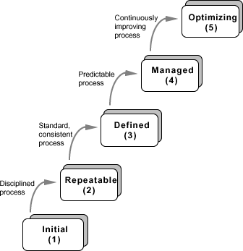

Slide 8
Level 1: Initial
Initial : The software process is characterized as ad hoc, and occasionally even chaotic. Few processes are defined, and success depends on individual effort.
  At this level, frequently have difficulty making commitments that the staff can meet with an orderly process
  Products developed are often over budget and schedule
  Wide variations in cost, schedule, functionality and quality targets
  Capability is a characteristic of the individuals, not of the organization

Slide 9
Level 2: Repeatable
Basic process management processes are established to track cost, schedule, and functionality. The necessary process discipline is in place to repeat earlier successes on projects with similar applications.
  Realistic project commitments based on results observed on previous projects
  Software project standards are defined and faithfully followed
  Processes may differ between projects
  Process is disciplined
  earlier successes can be repeated

Slide 10
Level 3: Defined
The software process for both management and engineering activities is documented, standardized, and integrated into a standard software process for the organization. All projects use an approved, tailored version of the organization’s standard software process for developing an maintaining software.

Slide 11
Level 4: Managed
Detailed measures of the software process and product quality are collected. Both the software process and products are quantitatively understood and controlled.
  Narrowing the variation in process performance to fall within acceptable quantitative bounds
  When known limits are exceeded, corrective action can be taken
  Quantifiable and predictable
    predict trends in process and product quality

Slide 12
Level 5: Optimizing
Continuous process improvement is enabled by quantitative feedback from the process and from piloting innovative ideas and technologies.
Goal is to prevent the occurrence of defects
  Causal analysis
Data on process effectiveness used for cost benefit analysis of new technologies and proposed process changes

Slide 13
Internal Structure to Maturity Levels
Except for level 1, each level is decomposed into key process areas (KPA)
Each KPA identifies a cluster of related activities that, when performed collectively, achieve a set of goals considered important for enhancing software capability.
  commitment
  ability
  activity
  measurement
  verification

Slide 14
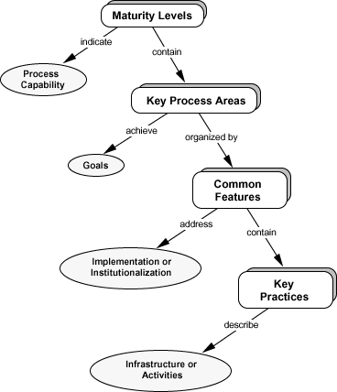

Slide 15
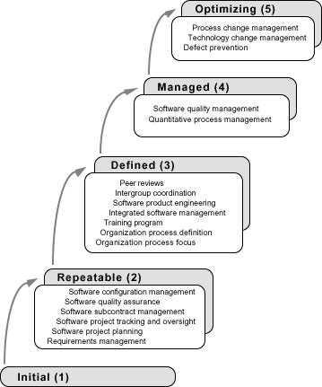

Slide 16
Level 2 KPAs
Requirements Management
  Establish common understanding of customer requirements between the customer and the software project
  Requirements is basis for planning and managing the software project
  Not working backwards from a given release date!
Software Project Planning
  Establish reasonable plans for performing the software engineering activities and for managing the software project

Slide 17
Level 2 KPAs
Software Project Tracking and Oversight
  Establish adequate visibility into actual progress
  Take effective actions when project’s performance deviates significantly from planned
Software Subcontract Management
  Manage projects outsourced to subcontractors
Software Quality Assurance
  Provide management with appropriate visibility into
    process being used by the software projects
    work products

Slide 18
Level 2 KPAs
Software Configuration Management
  Establish and maintain the integrity of work products
  Product baseline
  Baseline authority

Slide 19
Level 3 KPAs
Organization Process Focus
  Establish organizational responsibility for software process activities that improve the organization’s overall software process capability
Organization Process Definition
  Develop and maintain a usable set of software process assets
    stable foundation that can be institutionalized
    basis for defining meaningful data for quantitative process management

Slide 20
Level 3 KPAs
Training Program
  Develop skills and knowledge so that individual can perform their roles effectively and efficiently
  Organizational responsibility
  Needs identified by project
Integrated Software Management
  Integrated engineering and management activities
  Engineering and management processes are tailored from the organizational standard processes
  Tailoring based on business environment and project needs

Slide 21
Level 3 KPAs
Software Product Engineering
  technical activities of the project are well defined (SDLC)
  correct, consistent work products
Intergroup Coordination
  Software engineering groups participate actively with other groups
Peer Reviews
  early defect detection and removal
  better understanding of the products
  implemented with inspections, walkthroughs, etc

Slide 22
Level 4 KPAs
Quantitative Process Management
  control process performance quantitatively
  actual results from following a software process
  focus on identifying and correcting special causes of variation with respect to a baseline process
Software Quality Management
  quantitative understanding of software quality
    products
    process

Slide 23
Level 5 KPAs
Process Change Management
  continuous process improvement to improve quality, increase productivity, decrease cycle time
Technology Change Management
  identify and transfer beneficial new technologies
    tools
    methods
    processes
Defect Prevention
  causal analysis of defects to prevent recurrence

Slide 24
What are the benefits ?
Helps forge a shared vision of what software process improvement means for the organization
Defines set of priorities for addressing software problems
Supports measurement of process by providing framework for performing reliable and consistent appraisals
Provides framework for consistency of processes and product

Slide 25
Why measure software and software process?
Obtain data that helps us to better control
schedule
cost
quality of software products

Slide 26
Consistent measurement provide data for:
Quantitatively expressing requirements, goals, and acceptance criteria
Monitoring progress and anticipating problems
Quantifying tradeoffs used in allocating resources
Predicting schedule, cost and quality

Slide 27
Measurements
Historical
Plan
Actual
Projections

Slide 28
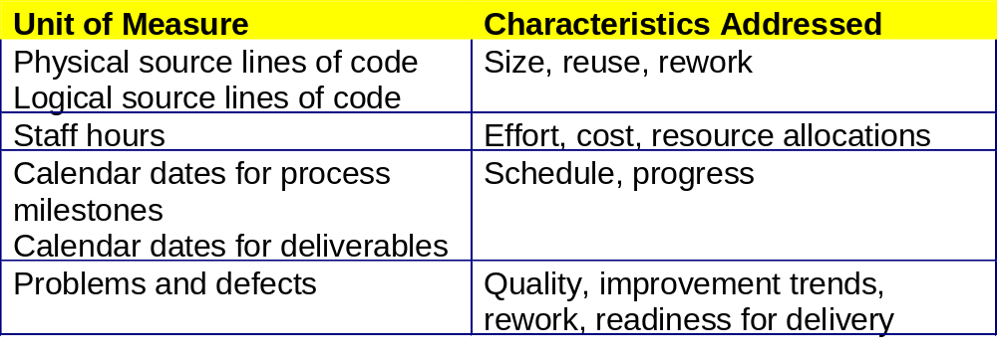
SEI Core Measures

Slide 29
Examples of measurements for size of work products
Estimated number of requirements
Actual number of requirements
Estimated source lines of code (SLOC)
Actual SLOC
Estimated number of test cases
Actual number of test cases

Slide 30
Example of measurements of effort
Estimated man-hours to design/code a given module
Actual man-hours expended for designing/coding the module
Estimated number of hours to run builds for a given release
Actual number of hours spent running builds for the release

Slide 31
Examples of measurements of quality of the work product
Number of issues raised at requirements inspection
Number of requirements issues open
Number of requirements issues closed
Number of issues raised during code inspection
Number of defects opened during unit testing

Slide 32
Examples of measurements of quality of the work product
Number of defects opened during system testing
Number of defects opened during UAT
Number of defects still open
Number of defects closed
Defect age

Slide 33
Examples of measurements of quality of the work product
Total number of build failures
Total number of defects fixed for a given release
Total number of defects verified and accepted
Total number of defects verified and rejected

